Slide 1

Neighborhood
Safety
Presentation
Fairfax County Police Department
Crime prevention unit

Slide 2
HOME SECURITY
OVERALL APPEARANCE OF YOUR HOME
Lawn Maintenance
Do not leave trash cans at curb
Do not leave mail and packages outside
LIGHTING…LIGHTING…LIGHTING
Darkness provides concealment, concealment provides comfort, comfort provides opportunity
Indoor/Outdoor
Timers
ALWAYS LOCK DOORS and WINDOWS
Trim down overgrown bushes- discourages hiding places
Increases risk of offender being detected/people feel safer
Gates – Locks
Create the illusion you are always home
Garage Doors Closed

Slide 3
HOME SECURITY
ALARMS
Glass breakage sensors on all bottom floor windows and doors
WINDOWS
Window Coverings
PETS
Doggie Doors
ONCE INSIDE
Looking for easy access to items
Jewelry in the usual locations
Office – financial/personal information
VEHICLES
Lock vehicle
Do not leave garage door opener in vehicle
Do not keep valuable items in plain view of your windows
Can put the car in the garage
Wireless, Monitored Alarm System
Silent vs audible
If going out of town leave a vehicle in the driveway

Slide 4

What is suspicious?
NOT NORMAL

Slide 5
Suspicious Activity
Suspicious activity can refer to incidents, events, individuals, or circumstances that seem unusual or out of place.
THERE ARE NO WRONG ANSWERS FOR WHAT IS SUSICIOUS ACTIVITY – IF YOU THINK IT IS SUSPICIOUS, IT IS!
IF YOU THINK, “SHOULD I CALL THE POLICE”. THE ANSWER IS YES
VIGILANT NEIGHBORHOODS TYPICALLY HAVE MORE CALLS FOR SERVICE AND LESS ACTUAL CRIME – BECAUSE PEOPLE ARE PAYING ATTENTION AND REPORTING WHAT THEY FIND SUSPICIOUS
NOT ALL SUSPICIOUS PERSONS ARE CRIMINALS

Slide 6
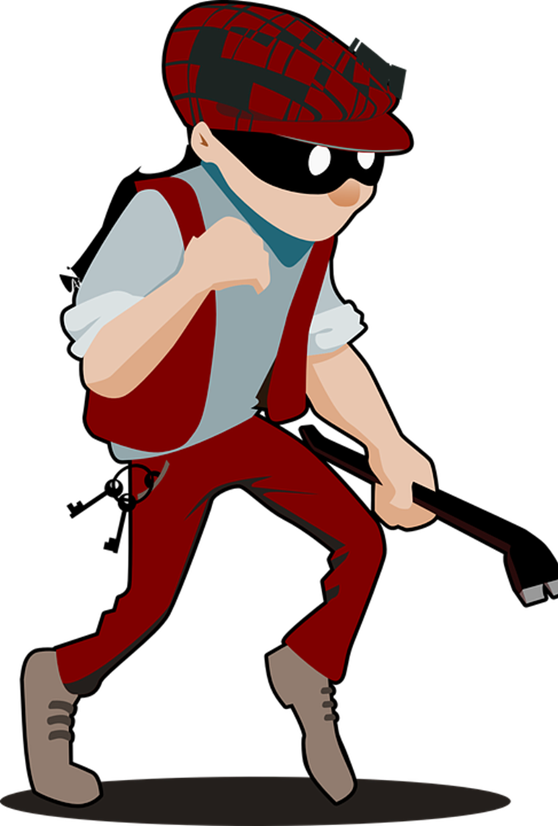
Reporting People
Begin with the basics
Move to the specifics
Gender
Race
Age
Height
Weight
Clothing
Hair Color
Facial Hair
Other Distinctive Identifiers – tattoos or scars

Slide 7

Vehicles: Begin with the basics
License Plate and State
Make and Model
Body Style – 2 door, 4 door, SUV, pickup
Color
Overall Appearance
Damage/Bumper stickers
Any other identifying items

Slide 8
NEIGHBORHOOD WATCH
ENHANCES REPORTING
PROMOTES NEIGHBORLINESS
THE COMMUNITY IS EMPOWERED TO REPORT ALL ACTIVTY OUT OF THE ORDINARY
LEADS TO MORE ACCURATE RECORDS OF SUSPICIOUS OR CRIMINAL ACTIVITY
THE EYES AND EARS OF THE COMMUNITY AT WORK!
ENCOURAGES INTERACTION WITH EACH OTHER
INFORMATION SHARING ABOUT HABITS AND THE HABITS OF OTHERS IN THE COMMUNITY
ENHANCES THE SAFETY AND SECURITY OF THE PEOPLE IN THE COMMUNITY

Slide 9

Inside the Mind of a Thief | Burglar Confessions - YouTube

Slide 10

Thank You
MPO Carolyn Beyer
McLean Crime Prevention
Carolyn.beyer@fairfaxcounty.gov

